Slide 1
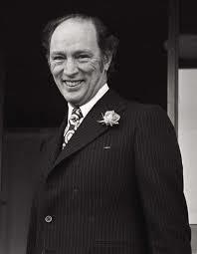
Pierre Elliot Trudeau
1919 – 2000
Prime Minister 1968 – 79
1980 - 84

Slide 2
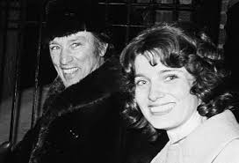
Marriage to Margaret Sinclair, daughter of a fellow MP, in 1971 (divorced 1984)

Slide 3
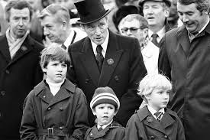
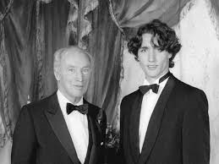
Justin, Alexandre, Michel (+1998)

Slide 4
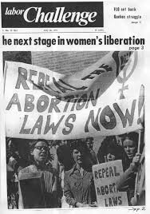
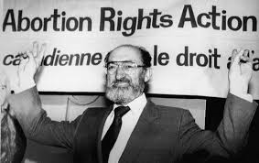
Henry Morgentaler, 1923 – 2013
Morgentaler vs. R (1975 lost)
R vs. Morgentaler (1988, won)

Slide 5
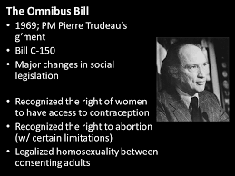
May 14th, 1969

Slide 6

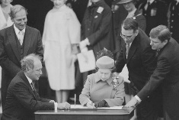
April 17th, 1982

Slide 7
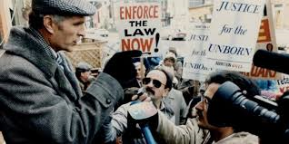
Joseph Borowski, 1933 – 1966.
Manitoba MLA, pro-life activist, right to life of the unborn (80 day hunger strike!
To the Supreme Court, which refused to hear his case in 1989.

Slide 8
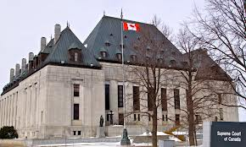
R. vs. Morgentaler, 1988
The Court left it to Parliament to come up with a new abortion law that would balance the rights of women with the state’s interest in the protection of the fetus, without offending the Charter.

Slide 9
Section 7 - Life, liberty and security of person
7. Everyone has the right to life, liberty and security of the person and the right not to be deprived thereof except in accordance with the principles of fundamental justice.

Slide 10
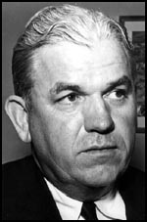
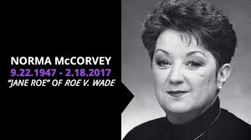
Henry Wade, District Attorney of Dallas County, 1951 - 1987
Roe v. Wade, 1973

Slide 11
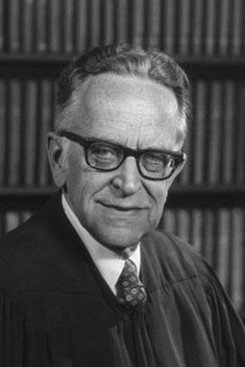
Roe v. Wade
In January 1973, the Supreme Court issued a 7–2 decision holding that the Due Process Clause of the Fourteenth Amendment to the U.S. Constitution provides a "right to privacy" that protects a pregnant woman's right to choose whether or not to have an abortion. (“nor shall any state deprive any person of life, liberty or property without due process of law”)
Harry Blackmun

Slide 12
The Court reasoned that outlawing abortions would infringe a pregnant woman's right to privacy for several reasons: having unwanted children "may force upon the woman a distressful life and future"; it may bring imminent psychological harm; caring for the child may tax the mother's physical and mental health; and because there may be "distress, for all concerned, associated with the unwanted child

Slide 13
However, it held that this right is not absolute, and must be balanced against the government's interests in protecting ‘women's health’ and protecting prenatal life.

Slide 14
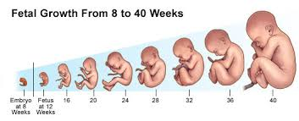
A ‘three trimester’ criteria:
During the first trimester, governments could not prohibit abortions at all
Second trimester, governments could require reasonable health regulations.
Third trimester, abortions could be prohibited entirely so long as the laws contained exceptions for cases when they were necessary to save the life or health of the mother.

Slide 15


Slide 16
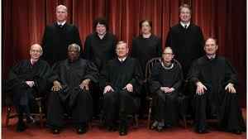
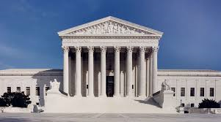
The Court classified the right to choose to have an abortion as "fundamental", which required courts to evaluate challenged abortion laws under the “strict scrutiny" standard, the highest level of judicial review in the United States.

Slide 17
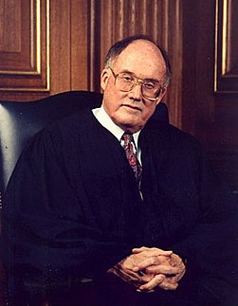
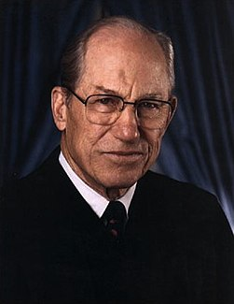
Two dissenters, William Rehnquist and Bryon White
No ‘right to privacy’ in the Constitution

Slide 18
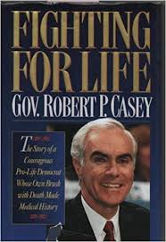
Robert Casey, Governor of Pennsylvania, instituted restrictions on abortion in light of Roe vs. Wade,
that required that a woman seeking an abortion give her informed consent,
that a minor seeking an abortion obtain parental consent (the provision included a judicial waiver option),
that a married woman notify her husband of her intended abortion,
and, finally, that clinics provide certain information to a woman seeking an abortion and wait 24 hours before performing the abortion.

Slide 19
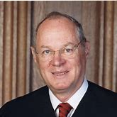
Planned Parenthood vs. Casey (1992)
Made illegal any law or restriction that placed an ‘undue burden’ on a woman’s ‘right’ to abortion.
At the heart of liberty is the right to define one's own concept of existence, of meaning, of the universe, and of the mystery of human life.
Justice Anthony Kennedy

Slide 20

March 25, 1995

Slide 21
The deliberate decision to deprive an innocent human being of his life is always morally evil and can never be licit either as an end in itself or as a means to a good end. It is in fact a grave act of disobedience to the moral law, and indeed to God himself, the author and guarantor of that law; it contradicts the fundamental virtues of justice and charity. "Nothing and no one can in any way permit the killing of an innocent human being, whether a fetus or an embryo, an infant or an adult, an old person, or one suffering from an incurable disease, or a person who is dying. Furthermore, no one is permitted to ask for this act of killing, either for himself or herself or for another person entrusted to his or her care, nor can he or she consent to it, either explicitly or implicitly. Nor can any authority legitimately recommend or permit such an action"

Slide 22
As far as the right to life is concerned, every innocent human being is absolutely equal to all others. This equality is the basis of all authentic social relationships which, to be truly such, can only be founded on truth and justice, recognizing and protecting every man and woman as a person and not as an object to be used. Before the moral norm which prohibits the direct taking of the life of an innocent human being "there are no privileges or exceptions for anyone. It makes no difference whether one is the master of the world or the ?poorest of the poor' on the face of the earth. Before the demands of morality we are all absolutely equal"

Slide 23
Among all the crimes which can be committed against life, procured abortion has characteristics making it particularly serious and deplorable. The Second Vatican Council defines abortion, together with infanticide, as an "unspeakable crime"

Slide 24
No one more absolutely innocent could be imagined. In no way could this human being ever be considered an aggressor, much less an unjust aggressor! He or she is weak, defenceless, even to the point of lacking that minimal form of defence consisting in the poignant power of a newborn baby's cries and tears. The unborn child is totally entrusted to the protection and care of the woman carrying him or her in the womb. And yet sometimes it is precisely the mother herself who makes the decision and asks for the child to be eliminated, and who then goes about having it done.

Slide 25
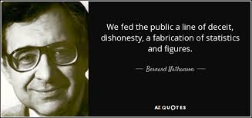
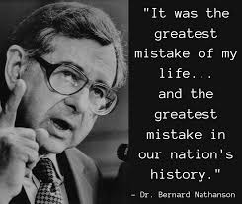
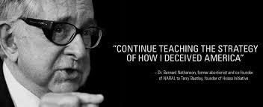
Dr. Bernard Nathanson
1926 - 2011

Slide 26
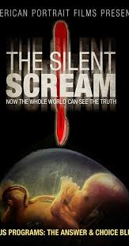
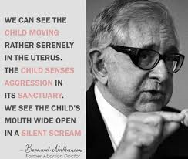
1984

Slide 27
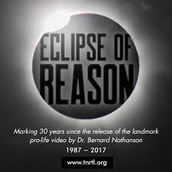
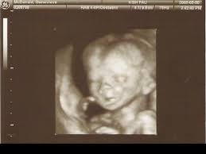
1987

Slide 28
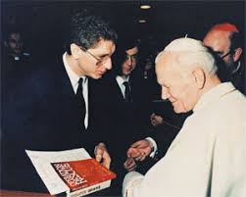
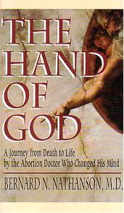
Conversion to Catholicism 1996
no religion matches the special role for forgiveness that is afforded by the Catholic Church

Slide 29
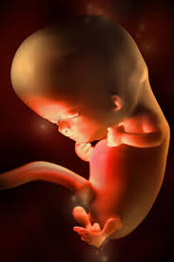
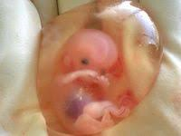
I was sitting in O.R.'s offices when I noticed a fetal development poster. The progression was so obvious, the eyes were so sweet. It hurt my heart, just looking at them. I ran outside and finally, it dawned on me. 'Norma', I said to myself, 'They're right'. I had worked with pregnant women for years. I had been through three pregnancies and deliveries myself. I should have known.
Yet something in that poster made me lose my breath. I kept seeing the picture of that tiny, 10-week-old embryo, and I said to myself, that's a baby! It's as if blinders just fell off my eyes and I suddenly understood the truth—that's a baby!

Slide 30
I felt crushed under the truth of this realization. I had to face up to the awful reality. Abortion wasn't about 'products of conception'. It wasn't about 'missed periods'. It was about children being killed in their mother's wombs.
All those years I was wrong. Signing that affidavit, I was wrong. Working in an abortion clinic, I was wrong. No more of this first trimester, second trimester, third trimester stuff. Abortion—at any point—was wrong. It was so clear. Painfully clear

Slide 31
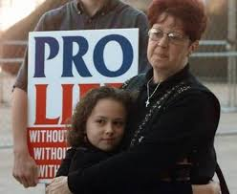
‘Jane Roe’ (Norma McCorvey)
Christianity, 1995
Conversion to Catholicism, 1998
+Feb, 18th, 2017

Slide 32
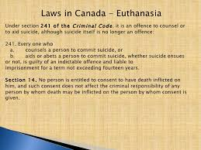
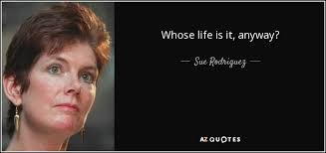
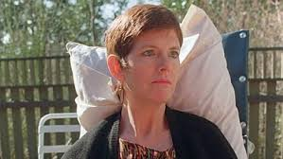
Supreme Court's 1993 ruling in Rodriguez v British Columbia (AG), which had denied a right to assisted suicide. (But a close 5-4 decision)

Slide 33

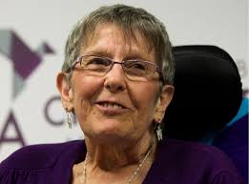
In a unanimous decision in Carter v. Canada, on February 6, 2015, the Court struck down the provision in the Criminal Code, thereby giving Canadian adults who are mentally competent and suffering intolerably and enduringly the right to a doctor's assistance in dying
Kay Carter
Gloria Taylor

Slide 34

Those who can provide medical assistance in dying services are:
Physicians
nurse practitioners (in provinces where this is allowed)
Those who can help provide medical assistance in dying include:
Pharmacists
family members or other people that you ask to help
health care providers who help physicians or nurse practitioners

Slide 35

directly administers a substance that causes death, such as an injection of a drug
  this is becoming known as clinician-administered medical assistance in dying
  it was previously known as voluntary euthanasia
Or
provides or prescribes a drug that the eligible person takes themselves, in order to bring about their own death
  this is becoming known as self-administered medical assistance in dying
  it was previously known as medically assisted suicide or assisted suicide

Slide 36
be at least 18 years old and mentally competent. This means being capable of making health care decisions for yourself.
have a grievous and irremediable medical condition
make a voluntary request for medical assistance in dying that is not the result of outside pressure or influence
give informed consent to receive medical assistance in dying

Slide 37
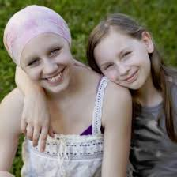

have a serious illness, disease or disability
be in an advanced state of decline that cannot be reversed
experience unbearable physical or mental suffering from your illness, disease, disability or state of decline that cannot be relieved under conditions that you consider acceptable
be at a point where your natural death has become reasonably foreseeable
  this takes into account all of your medical circumstances and does not require a specific prognosis as to how long you have left to live
You do not need to have a fatal or terminal condition to be eligible for medical assistance in dying.

Slide 38
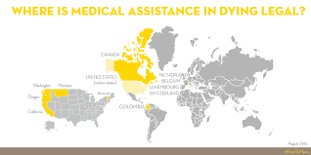
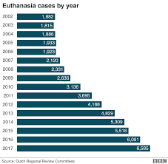

Slide 39
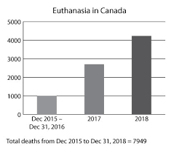

Slide 40
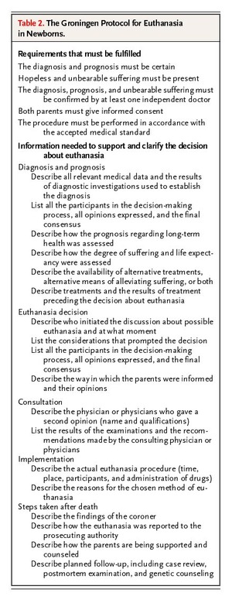

Slide 41
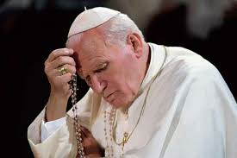
Euthanasia in the strict sense is understood to be an action or omission which of itself and by intention causes death, with the purpose of eliminating all suffering. "Euthanasia's terms of reference, therefore, are to be found in the intention of the will and in the methods used".

Slide 42
To concur with the intention of another person to commit suicide and to help in carrying it out through so-called "assisted suicide" means to cooperate in, and at times to be the actual perpetrator of, an injustice which can never be excused, even if it is requested.

Slide 43
euthanasia must be called a false mercy, and indeed a disturbing "perversion" of mercy. True "compassion" leads to sharing another's pain; it does not kill the person whose suffering we cannot bear. Moreover, the act of euthanasia appears all the more perverse if it is carried out by those, like relatives, who are supposed to treat a family member with patience and love, or by those, such as doctors, who by virtue of their specific profession are supposed to care for the sick person even in the most painful terminal stages

Slide 44
The choice of euthanasia becomes more serious when it takes the form of a murder committed by others on a person who has in no way requested it and who has never consented to it. The height of arbitrariness and injustice is reached when certain people, such as physicians or legislators, arrogate to themselves the power to decide who ought to live and who ought to die. Once again we find ourselves before the temptation of Eden: to become like God who "knows good and evil" (cf. Gen 3:5).

Slide 45
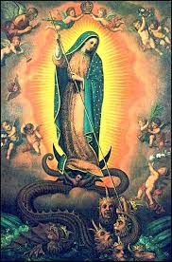
Mary thus helps the Church to realize that life is always at the centre of a great struggle between good and evil, between light and darkness. The dragon wishes to devour "the child brought forth" (cf. Rev 12:4), a figure of Christ, whom Mary brought forth "in the fullness of time" (Gal 4:4) and whom the Church must unceasingly offer to people in every age

Slide 46
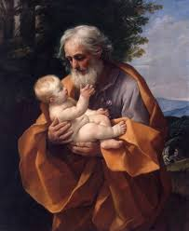
But in a way that child is also a figure of every person, every child, especially every helpless baby whose life is threatened, because-as the Council reminds us-"by his Incarnation the Son of God has united himself in some fashion with every person". It is precisely in the "flesh" of every person that Christ continues to reveal himself and to enter into fellowship with us, so that rejection of human life, in whatever form that rejection takes, is really a rejection of Christ.

